Slide 1
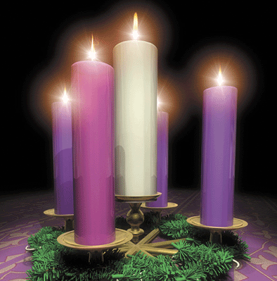
Please Join St. Mary’s Candlelight Services:
Wednesday December 6 at 7 PM
Wednesday December 13 at 7 PM
Wednesday December 20 Blue Christmas at 7 PM
All Services will be held in the Main Sanctuary
St Mary’s Anglican Church
10030 Yonge St., Richmond Hill, On

